Slide 1
Practical Considerations in Seamless Phase II/III Adaptive Designs with Treatment Selection
Dong Xi, Ya Wang Biostatistics Innovation Group (BIG) April 18, 2023
Acknowledgement: Oksana Gurtovaya, Lixin Shao, Jeni Zhou, Li Dong, Jialuo Liu

Slide 2
Conventional Clinical Development Plan
Phase I
Phase 2a
Phase 2b
Phase 3
Healthy volunteers
First-in-human
Safety
PK/PD
First-in-patients
Proof-of-concept to show if a particular dose is promising
Dose (range) finding
Select one (or two) dose
Confirmatory trial
Usually, for non-oncology drug development which has a lower tolerance on safety issues
Lower dose(s) with better safety profile and adequate efficacy is often chosen for Phase 3
Recently, oncology development also considers dose optimization based on safety and efficacy
FDA Project Optimus

Slide 3
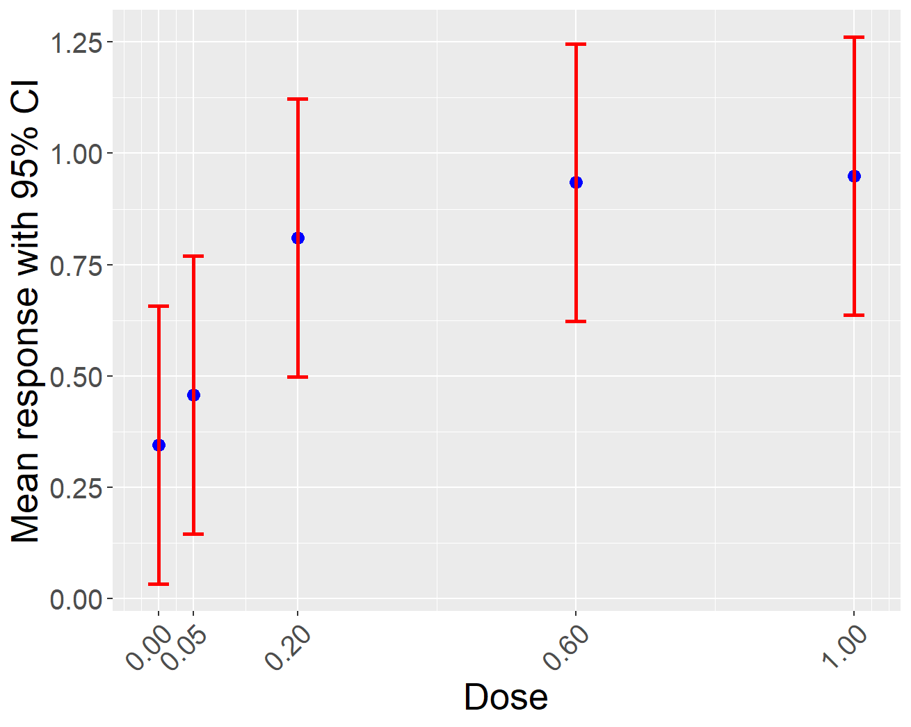
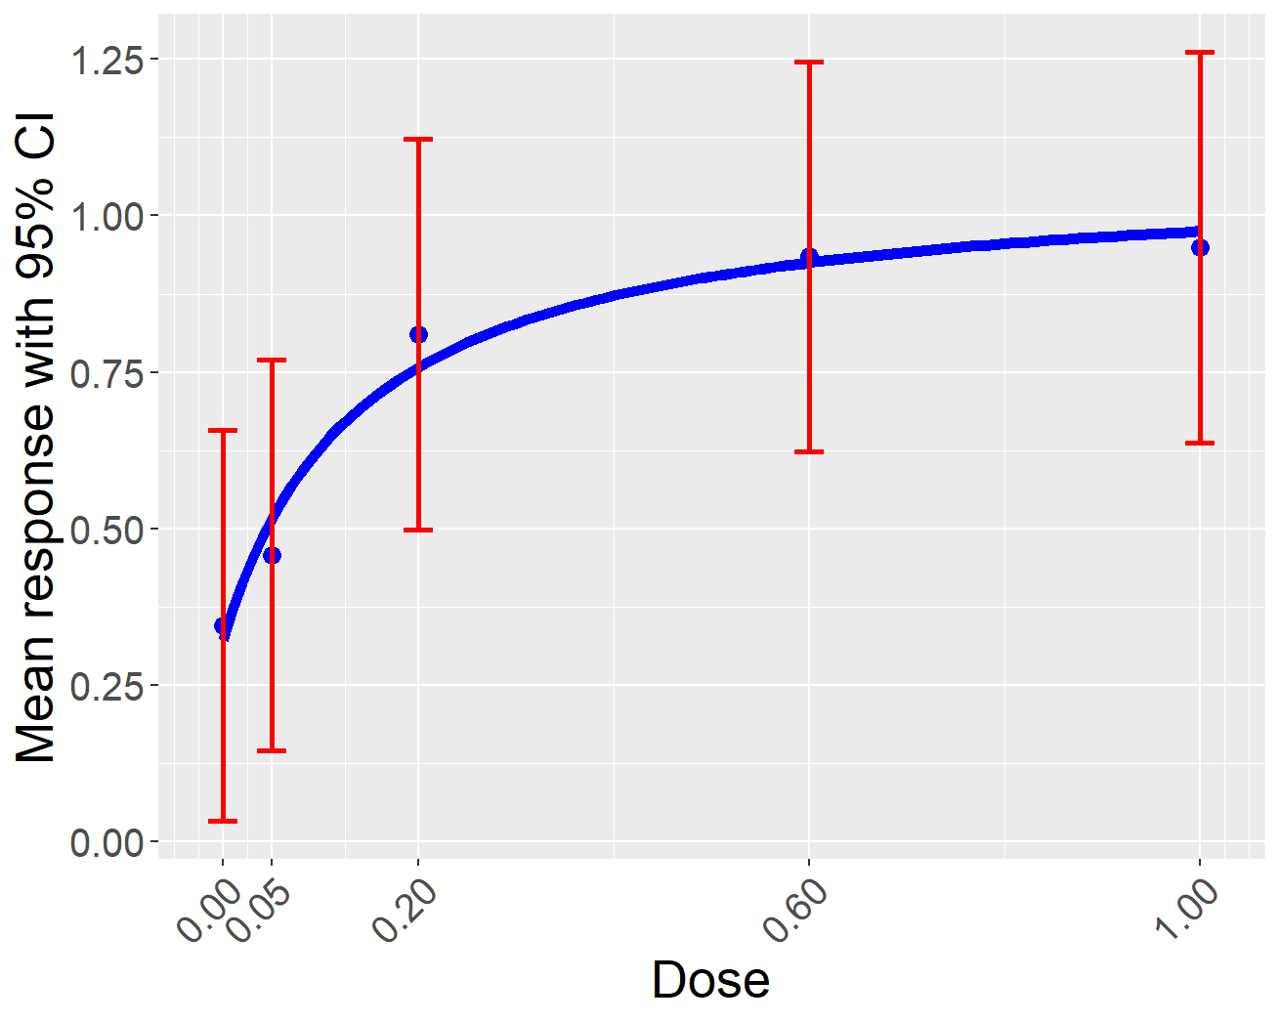
Methodologies for Dose Finding
Suppose we include a placebo arm and a few active arms for different doses
Approaches focus on
Hypothesis testing: comparisons of doses vs. placebo
Pairwise comparisons
Estimation: dose-response curve
Hybrid approach, e.g., MCP-Mod
Design operating characteristics
Power to reject a null hypothesis
Precision of estimation
Probability of selecting the target dose
The minimal dose achieving a target treatment effect

Slide 4
Conventional Design
Phase 2b
Phase 3
High dose
Medium dose
Transition Period
Low dose
Placebo
During the transition period
End of Phase 2 (EOP2) meeting with FDA to obtain the agreement on the dose selection and study design for Phase 3
Not most efficient in terms of time and patient exposure
More robust development with adequate time to integrate all available information

Slide 5
Seamless Phase 2/3 Design
Stage 1
Stage 2
High dose
Medium dose
More planning
Interim analysis
Low dose
Placebo
Combine Phase 2b (as stage 1) and Phase 3 (as stage 2) into one trial
Use the interim analysis to perform dose selection
At the end of Phase 3, use data from both stages for confirmatory testing
More efficient in terms of time and patient exposure
More careful planning and less time to make dose selection

Slide 6
Popular Design Features
Stage 1
Stage 2
High dose
Medium dose
More planning
Interim analysis
Low dose
Placebo
At interim analysis
Futility stopping of the study
Dose selection
More often to start with a few doses and then drop some
Less often to add dose(s)
Sample size re-estimation

Slide 7
Futility Stopping
Similar rationales compared to futility stopping in Phase 3 trials with two arms
Trade-offs between power loss and probability of stopping under null
The more aggressive the futility, the more the power loss, the higher the prob of stopping
The earlier the futility, the more the power loss, the high the prob of stopping
Decision metrics should be able to integrate all information from all doses for efficiency
An overall p-value of all doses vs. placebo
E.g., the MCP test of the overall dose-response signal in MCP-Mod
Always helpful to also report the futility boundary on the point estimate scale for easier communication

Slide 8
Dose Selection
Could be based on treatment effect for each dose
E.g., the dose with the best treatment effect compared with placebo
More efficient to use estimates from dose-response modeling to borrow information across doses
Decision could be based on data at an earlier timepoint (e.g., week 24 in a 52-week study)
Or surrogate endpoints
Often preferred when the primary outcome take a long time to measure
Safety information is usually integrated in a qualitative manner
Sometimes, we may want the flexibility to choose one or two doses for stage 2 based on data
Need to pre-specify selection rules for the alignment internally and externally
Health authority buy-in needed (of the algorithm, instead of the dose)

Slide 9
Sample Size Re-estimation (SSR)
Possible to change the sample size of stage 2 for the chosen dose(s)
E.g., change the per arm sample size from 50 to 100 for stage 2
Techniques for SSR for a single endpoint apply
SSR could also be implicitly implemented
E.g., at the interim analysis, one or two doses will be selected
Regardless of which dose(s), the total sample size for stage 2 is 300
If only one dose is selected, this means an increase of sample size
Need to adjust for this implicit SSR or otherwise type I error will be inflated
For dose selection, need to discuss how to handle sample size change, e.g., for each arm or for the study

Slide 10
Design Parameters
Sample size
Stage 1 sample size affects the performance of the interim analysis (and final analysis)
E.g., timing of futility, dose-response estimation and selection reliability
Stage 1+2 sample size affects the final study power
Decision thresholds
Futility stopping
Dose selection

Slide 11
Recruitment
When enough patients enrolled for the interim analysis, recruitment could be stopped
Avoid assigning patients to to-be-dropped arms
But resuming recruitment could be time-(and effort-)consuming
When enough patients enrolled for the interim analysis, recruitment could continue
Patients may be assigned to unselected doses (waste of patient exposure)
Recruitment could be slowed down to minimize the waste
More preferred option
Ideally, futility analysis preferred before all patients recruited to potentially save resources

Slide 12
Categorization of patients for data combination
Usually, patients recruited up to the interim analysis are considered as stage 1 patients
All data (early endpoints, safety) could be used for decision making at the interim analysis
The rest are stage 2 patients
W52
W24
1
2
3
4
Stage 1 patients
5
6
Stage 2 patients
Patients
7
8
9
10
11
12
13
Interim analysis when 5 patients have W24 data
Time

Slide 13
Search for Optimal Designs
Given many design parameters (sample size(s), decision thresholds), there are many feasible combinations
We could search for optimal designs satisfying preferred operating characteristics (OCs)
Power (affected by sample size)
Power loss and prob of stopping (sample size, futility threshold)
Prob of selecting the correct dose (sample size, selection threshold)
Where to find targets for these OCs?
Conventional designs as the benchmark
Design conventional Phase 2b and 3 trials with desired OCs and use these to guide the search

Slide 14
Lupus Erythematosus
Systemic Lupus Erythematosus (SLE)
Chronic with periods of flare and remission, with multi-organ involvement
Heterogenic, may affect different body systems at different times
~ 0.1% of population (~ 1 million in US): Females 90%
Highest mortality rate in auto-immune diseases
Slow enrollment in clinical trials

Slide 15
Clinical Development Plan (CDP) Options for Systemic Lupus Erythematosus (SLE)
Option A: Conventional CDP
Option B: CDP with a seamless design
Ph2b with three doses and placebo
Two Ph3 trials with one dose and placebo
Optional futility
Dose selection
Seamless Ph2/3 with initially three doses and placebo, and dose selection
Ph3 trial with one dose and placebo

Slide 16
Common Performance Criteria
Type I error control
One-sided 0.05 for Ph2b; One-sided 0.025 for Ph3
Power
80% for Ph2b; 90% for Ph3
Futility
Prob of stopping for futility if no effect (Stop) ≥ 65% (trial-specific)
Usually ≥ 50%
The larger, the more aggressive futility rule
Power loss after adding futility (Power loss) ≤ 3% for Ph2b and ≤ 2% for Ph3 (trial-specific)
Usually ≤ 5%
The larger, the more aggressive futility rule

Slide 17
Common Assumptions
Binary endpoint: BICLA (BILAG-Based Combined Lupus Assessment)
Placebo 35% and max treatment effect 20% (i.e., 55% for the best dose)
Two key assessment timepoints
Week 24 (futility, dose response modeling)
Week 52 (confirmatory testing)
Correlation: 0.7
MCP-Mod for dose response modeling
Week 52 confirmatory pairwise comparisons for difference in response rates
Bonferroni-based test for multiplicity adjustment
Recruitment rate: 20 patients per month for Ph2b and 28 for Ph3
1 (3) month to perform interim (final) analysis
6 months for EOP2 meeting and 9 months to plan Ph3

Slide 18
Search for Feasible Designs
Grid search
Sample size (e.g., 50, 60, …, 190, 200)
Timing for futility analysis (e.g., 40%, 50%, 60% …)
Threshold for futility analysis (e.g., p-value for MCP test 0.05, 0.1, 0.15, 0.2 …)
Given these performance criteria and assumptions, grid search over millions of combinations of design parameters
Calculate “power”, “power loss” and “stop under null” for each case
Find feasible designs based on pre-defined performance criteria
Finally compare sample size and timeline for selected designs

Slide 19
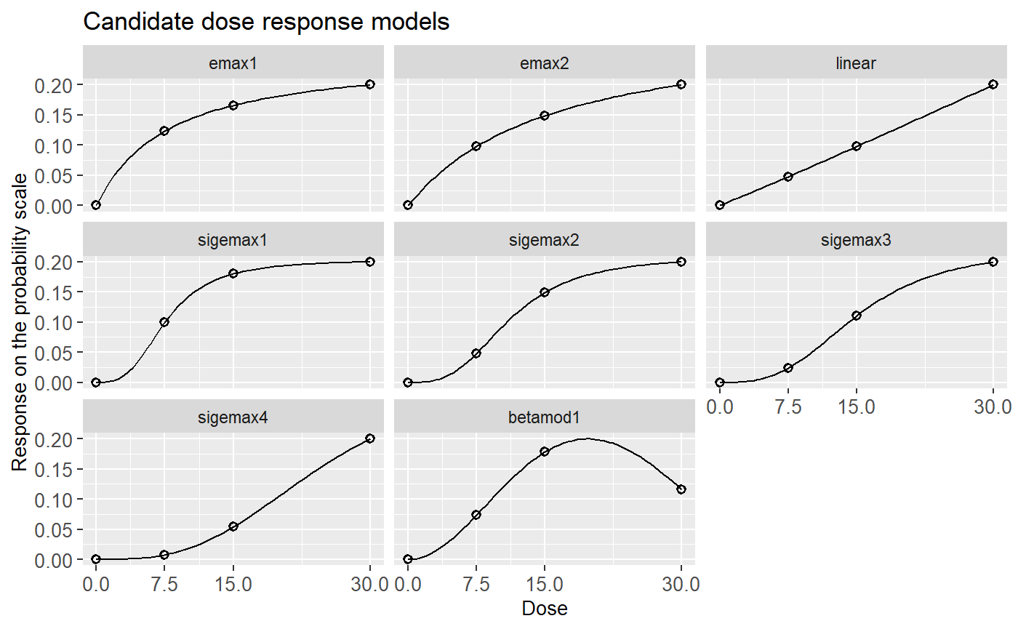
Candidate Dose Response Models (Truths)
8 candidate dose response models covering monotonic and non-monotonic shapes
OCs are averaged over these 8 scenarios

Slide 20
Option A: Ph2b Considerations
Ph2b study with primary analysis at Week 24
Sample size: X per arm for 3 doses (7.5mg, 15mg, 30mg) and placebo
Final success if the MCP-Mod test is significant at level 0.05 (one-sided)
Timing: One futility analysis when Y patients have week-24 BICLA
Futility if the MCP-Mod test is insignificant at level Z (one-sided)
Preferred OCs
At least 10% of sample size saved if stopping at the futility interim
Power to detect a significant dose-response signal (Power under alt) ≥ 80%
Prob of stopping for futility if no effect (Stop under null) ≥ 65%
1% ≤ Power loss after adding futility (Power loss) ≤ 3%

Slide 21
Option A: Ph2b Feasible Designs
 | Inputs |  |  | Outputs
 | Sample size per arm | Futility analysis |  |  |  | Power under alt | Stop under null | Power loss
Choice | Sample size per arm | Timing | P-value | Diff in rates | Enrollment | Power | Stop | Power loss
1 | 90 | 45 | 0.35 | 0.05 | 73 | 84.4% | 68.3% | 2.2%
2 | 95 | 48 | 0.30 | 0.07 | 76 | 84.8% | 70.0% | 2.9%
3 | 95 | 48 | 0.35 | 0.05 | 76 | 85.6% | 65.5% | 2.1%
4 | 100 | 50 | 0.30 | 0.07 | 78 | 86.1% | 68.9% | 3.0%
5 | 100 | 55 | 0.25 | 0.09 | 83 | 85.4% | 75.6% | 3.0%
6 | 100 | 55 | 0.30 | 0.07 | 83 | 86.4% | 70.7% | 1.9%
7 | 100 | 55 | 0.35 | 0.05 | 83 | 87.2% | 65.6% | 1.2%

Slide 22
Option A: Ph3 Considerations
Two identical Ph3 52-week study with one dose and placebo
One futility analysis at 50% information for week-24 BICLA with a p-value boundary of 0.35 (one-sided)
Prob of stopping for futility if no effect: 69%
Power loss after adding futility: 1.5%
Sample size is 132 per arm for 90% power
Option A summary
Sample size: 95 * 4 (Ph2b) + 132 * 2 * 2 (Ph3) = 908
Duration: 25 (Ph2b) + 18 + 22 (Ph3) = 65 months
Notes:
25 = 95 * 4 / 20 + 24 / 4
18 = 3 (final analysis) + 6 (EOP2) + 9 (phase 3 planning)
22 = 132 * 2 / 28 + 52 / 4

Slide 23
Option B: Ph2/3 Considerations
Seamless Ph2/3 52-week study with dose selection
Stage 1: Three doses (7.5mg, 15mg, 30mg) and placebo
One futility analysis based on week-24 BICLA
Select one dose with the highest treatment effect to continue to stage 2
Stage 2: Selected active doses and placebo
Bonferroni-based comparisons based on week-52 BICLA at significance level 0.025 (one-sided)
Inverse normal combination test to combine p-values from stage 1 and 2

Slide 24
Option B: Ph2/3 Design Criteria
Sample size: maximum X per arm across both stages
Timing: Futility analysis when Y patients have week-24 BICLA in stage 1
Futility if the optimal MCP test is insignificant at level Z (one-sided)
Preferred OCs
Power to detect a significant treatment effect (Power) ≥ 90%
Prob of stopping for futility if no effect (Stop) ≥ 65%
Power loss after adding futility (Power loss) ≤ 2%

Slide 25
Option B: Ph2/3 Feasible Designs with One Dose Selected
 | Inputs |  |  | Outputs
 | Sample size per arm | Futility analysis |  |  |  | Power under alt | Stop under null | Power loss
Choice | Sample size per arm | Timing | P-value | Diff in rates | Enrollment | Power | Stop | Power loss
1 | 180 | 81 | 0.25 | 0.09 | 109 | 90.5% | 74.4% | 1.6%
2 | 180 | 81 | 0.30 | 0.07 | 109 | 91.1% | 69.2% | 1.0%
3 | 190 | 76 | 0.30 | 0.07 | 104 | 91.0% | 69.8% | 1.7%
4 | 190 | 86 | 0.25 | 0.09 | 113 | 91.6% | 74.8% | 1.7%
5 | 190 | 86 | 0.30 | 0.07 | 113 | 92.1% | 70.0% | 1.2%
Notes:
Choice 2 has similar operating characteristics compared to Ph3 in Option A

Slide 26
Option B: Ph2/3 Dose Selection
Candidate models | Choice | Prob. select 30 mg | Prob. select 15 mg | Prob. select 7.5 mg
Averaged over 7 monotonic models (best dose: 30mg) | 1 | 99.4% | 0.5% | 0.1%
10% | 2 | 99.3% | 0.5% | 0.1%
10% | 3 | 99.3% | 0.5% | 0.2%
10% | 4 | 99.4% | 0.4% | 0.1%
10% | 5 | 99.4% | 0.4% | 0.2%
One non-monotonic model (best dose: 15mg) | 1 | 86.8% | 11.3% | 1.8%
 | 2 | 86.1% | 11.4% | 2.5%
 | 3 | 84.4% | 13.7% | 1.9%
 | 4 | 86.4% | 11.7% | 1.9%
 | 5 | 85.7% | 11.8% | 2.5%

Slide 27
Comparison if one dose is selected for Ph3
Option A summary
Sample size: 95 * 4 (Ph2b) + 132 * 2 * 2 (Ph3) = 908
Duration: 25 (Ph2b) + 18 + 22 (Ph3) = 65 months
Option B summary
Pessimistic sample size: 109 * 4 + 20 (stage 1) + 66 * 2 (stage 2) + 132 * 2 (Ph3) = 852
109 (recruited by the interim analysis) could be reduced if slowing down recruitment
Pessimistic duration: 5 + 23 (stage 1) + max{18 (stage 2), 9 + 22 (Ph3)} = 59 months
5 (extra planning) and 9 (2nd Ph3 planning) could be shortened
Scenario​ | Time to registration (month)​ | Total sample size​
A (Conventional)​ | 65 | 908
B (Seamless) | 59 | 852
Notes:
Sample size: 109 * 4 (ph2/3 stage 1 enrollment at the time of interim) + 20 (1 month for interim analysis) + 66 * 2 (ph2/3 stage 2 enrollment) + 132 * 2 (second ph3 conduct) = 852
Conservative duration: 5 (Ph2/3 preparations) + 109 * 4 (ph2/3 stage 1 enrollment at the time of interim) / 20 (ph2 recruitment/month) + 1 (interim analysis) + max of { 66 * 2 (ph2/3 stage 2 enrollment) / 28 + 13 (ph2/3 52-week follow-up) , 9 (second Ph3 planning) + 22(second ph3 conduct) } = 59

Slide 28
When to Consider Seamless Designs
Relatively predictable dose response relationships
E.g., predictable PK-PD behaviors
Well-understood dose responses from drugs in the same class
Longer-term outcome for approval but shorter-term outcome for dose selection
For SLE, outcome for approval is at W52 and for dose selection is at W24
More savings would be achieved if an even earlier outcome than W24 can be used
Need to expedite the drug development with enough resources and team’s dedication and trust on DMC
Ideas could be utilized in other situations (Ph1/2, Oncology Ph2/3 …)

Slide 29
R package {SeamlessDesignSimulation}
To facilitate simulation and analysis of seamless Phase 2/3 clinical trials
Simulation module
Simulate patient-level data with a Poisson-distributed enrollment
Two main analysis timepoints
Interim for dose selection and futility (optional)
Final for confirmatory testing
Timing of interim analysis driven by user-specified % of patients for analysis (e.g., when 100 patient have data)
Binary outcome
Allow a different outcome at interim (e.g., W24) for dose selection and another (e.g., W52) for final testing

Slide 30
R package {SeamlessDesignSimulation}
Analysis module
Interim analysis
Dose selection based on model-based treatment effects from MCP-Mod
Use-defined dose selection criteria
Futility analysis (optional)
Using MCP-Mod and flexible timing
Final analysis
Cochran-Mantel-Haenszel (CMH) test comparing each selected dose vs. placebo at each stage
Inverse normal combination test to combine p-values from stage 1 and 2
Multiple adjustment using Bonferroni correction (could use other tests)

Slide 31
R package {SeamlessDesignSimulation}
Operating characteristics
Power to detect a significant treatment effect
Prob of stopping for futility
Power loss after adding futility
Probability of selecting one dose, …, user-specified max number of doses
Other summaries
Average number of true efficacious doses
Average number of patients enrolled at interim analysis
Average number of patients included in the interim /futility / final analyses

Slide 32
R package {SeamlessDesignSimulation}
Key Function | Description | S3 Methods for Extension
SetupSimulationPacket | Set up simulation details for all scenarios that are needed, e.g., assign class to S3 methods
RunSimulation RunParallelSimulation | RunSimulation will loop over scenarios and simulate each scenario RunParallelSimulation does the same as but uses multiple cores
SimulateSingleTrial | Simulate a single trial
SimulateAllPatientData | Simulate the patient data based on the input parameter for multiple arms
SimulatePatientOutcomes | Simulate patient outcomes. Currently support binary outcomes with specified response rates at each analysis timepoint and correlations between them | √
RunAnalysis | Run the desired analysis Currently support MCP-Mod and CMH | √
SelectTreatment | Select treatments based on interim analysis results
CombinePvalues | Combine p-values from stage 1 and 2 using the desired method Currently support Inverse Normal Combination | √
MultipleComparison | Compute multiple comparison corrected p-value Currently support Bonferroni correction | √
PostProcess | Conduct the post-process work for the simulation results and output summary

Slide 33

THANK YOU

Slide 34
Option B: Ph2/3 Feasible Designs with Two Doses Selected
 | Inputs |  |  | Outputs
 | Sample size per arm | Futility analysis |  |  |  | Power under alt | Stop under null | Power loss
Choice | Sample size per arm | Timing | P-value | Diff in rates | Enrollment | Power | Stop | Power loss
1 | 170 | 77 | 0.25 | 0.09 | 104 | 90.4% | 74.4% | 2.0%
2 | 170 | 77 | 0.30 | 0.07 | 104 | 91.0% | 69.3% | 1.4%
3 | 180 | 81 | 0.25 | 0.09 | 109 | 92.0% | 74.4% | 2.0%
4 | 180 | 81 | 0.30 | 0.07 | 109 | 92.6% | 69.2% | 1.3%
5 | 190 | 76 | 0.30 | 0.07 | 104 | 92.5% | 69.8% | 1.9%
6 | 190 | 86 | 0.25 | 0.09 | 113 | 92.8% | 74.8% | 1.8%
7 | 190 | 86 | 0.30 | 0.07 | 113 | 93.4% | 70.0% | 1.3%
Notes:
Choice 2 has similar operating characteristics compared to Ph3 in Option A

Slide 35
Option A: Ph3 Considerations
Two identical Ph3 52-week study with one dose and placebo
One futility analysis at 50% information for week-24 BICLA with a p-value boundary of 0.25 (one-sided)
Prob of stopping for futility if no effect: 63%
Power loss after adding futility: 1.5%
Sample size is 156 per arm for 90% power
Option A summary
Sample size: 95 * 4 (Ph2b) + 156 * 3 * 2 (Ph3) = 1316
Duration: 25 (Ph2b) + 18 + 30 (Ph3) = 73 months
Notes:
25 = 95 * 4 / 20 + 24 / 4
18 = 3 (final analysis) + 6 (EOP2) + 9 (phase 3 planning)
30 = 156 * 3 / 28 + 52 / 4

Slide 36
Comparison if two doses are selected for Ph3
Option A summary
Sample size: 95 * 4 (Ph2b) + 156 * 3 * 2 (Ph3) = 1316
Duration: 25 (Ph2b) + 18 + 30 (Ph3) = 73 months
Option B summary
Sample size: 104 * 4 + 20 (stage 1) + 61 * 3 (stage 2) + 156 * 3 (Ph3) = 1087
Duration: 5 (extra planning) + 22 (stage 1) + 39 (stage 2 and Ph3) = 66 months
Scenario​ | Time to registration (month)​ | Total sample size​
A (Conventional)​ | 73 | 1316
B (Seamless) | 67 | 1087
Notes:
Sample size: 104 * 4 (ph2/3 stage 1 enrollment at the time of interim) + 20 (1 month for interim analysis) + 61 * 3 (ph2/3 stage 2 enrollment) + 156 * 3 (second ph3 conduct) = 1087
Conservative duration: 5 (Ph2/3 preparations) + 104 * 4 (ph2/3 stage 1 enrollment at the time of interim) / 20 (ph2 recruitment/month) + 1 (interim analysis) + max of { 61 * 3 (ph2/3 stage 2 enrollment) / 28 + 13 (ph2/3 52-week follow-up) , 9 (second Ph3 planning) + 30(second ph3 conduct) } = 66

Slide 37
Comparison
If one dose is selected for Ph3
If two doses are selected for Ph3
Scenario​ | Time to registration (month)​ | Total sample size​
A (Conventional)​ | 65 | 908
B (Seamless) | 59 | 852
Scenario​ | Time to registration (month)​ | Total sample size​
A (Conventional)​ | 73 | 1316
B (Seamless) | 67 | 1087

